Slide 1
Capstone Project Analyzing the neighborhoods of New-York city and Toronto
Applied Data Science Capstone by IBM/Coursera

Slide 2
Table of contents
Introduction
Data Description
Methodology
Results
Discussion
Conclusion

Slide 3
Introduction
New York City is the most populous city in the United States. It is also the most densely populated major city in the United States. It has been described as the cultural, financial, and media capital of the world, significantly influencing commerce, entertainment, research, technology, education, politics, tourism, art, fashion, and sports.
Toronto is the capital city of the Canadian province of Ontario. it is the most populous city in Canada and the fourth most populous city in North America. Toronto is an international center of business, finance, arts, and culture, and is recognized as one of the most multicultural and cosmopolitan cities in the world.

Slide 4
Business Problem
The aim is to help tourists choose their destinations depending on the experiences that the neighborhoods have to offer and what they would want to have.
This also helps people make decisions if they are thinking about migrating to New York City or Toronto or even if they want to relocate neighborhoods within the city.

Slide 5
Target Audience / Stakeholders
Help tourists to choose their destinations/Venues.
Helps Business personnel to know which are the best places to invest or to do business.
Helps people make decisions if they are thinking about migrating/relocating neighborhoods within the city.
Helps stakeholders to choose different kinds of restaurants, venues and what the city has to offer.

Slide 6
Data Description
We require geolocation data for both New York City and Toronto. We use Geographical Location data using Geocoder Package Data Source: https://cocl.us/Geospatial_data
This project aims to leverage venue data from Foursquare’s ‘Places API’ Venue Data using Foursquare API Data Source: https://foursquare.com/developers/apps
Machine learning algorithm called ‘k-means clustering’ to identify ‘New York City’ and Toronto neighborhoods.

Slide 7
New York City : Data Source and Description
The "New York City Neighborhood Names" dataset hosted by NYU’s Spatial Data Repository forms as the basis for the neighborhood names and associated location centroids.
To derive our solution, we leverage same json data available at "Skills Network Lab" ,https://cf-courses-data.s3.us.cloud-object-storage.appdomain.cloud/IBMDeveloperSkillsNetwork-DS0701EN-SkillsNetwork/labs/newyork_data.json.
The ‘Borough’, ‘Neighborhood’, ‘Latitude’, and ‘Longitude’ values associated with each neighborhood were then converted from JSON to a Pandas DataFrame that serves as the foundation of the analysis.

Slide 8
Toronto : Data Source and Description
Postal codes of Canada available at Wikipedia page serve as a starting point. Using Postal codes we can find out the neighborhoods, boroughs, venues and their most popular venue categories.
To derive our solution, we scrape our data from Wikipedia https://en.wikipedia.org/wiki/List_of_postal_codes_of_Canada:_M. This Wikipedia page has information about all the neighborhoods, we limit it to Toronto.
This dataset has information about Postal Code, Borough, Neighborhoods etc.
Using Beautiful Soup the data is preprocessed and then converted to a Pandas DataFrame that serves as the foundation of the analysis.

Slide 9
Foursquare API Data
"Foursquare" locational information is used to obtain data about different venues in different neighborhoods of that specific borough.
Foursquare is a location data provider with information about venues and events within an area of interest. Such information includes venue names, locations, menus and even photos.
The data retrieved from Foursquare contained information of venues within a specified distance of the longitude and latitude of the postcodes.

Slide 10
TechStack / framework Used
Machine Learning Algorithm
Web Scraping
Foursquare API
Geocoder
Python / Pandas DataFrame
Beautiful Soup
Folium

Slide 11
Methodology Section
Prerequisite
import numpy as np # library to handle data in a vectorized manner
import pandas as pd # library for data analysis
import json # library to handle JSON files
from geopy.geocoders import Nominatim # convert an address into latitude and longitude values
import requests # library to handle requests
from pandas.io.json import json_normalize # tranform JSON file into a pandas dataframe
import matplotlib.cm as cm
import matplotlib.colors as colors
from sklearn.cluster import KMeans
#import folium # map rendering library

Slide 12
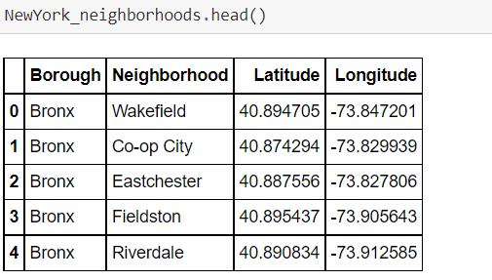
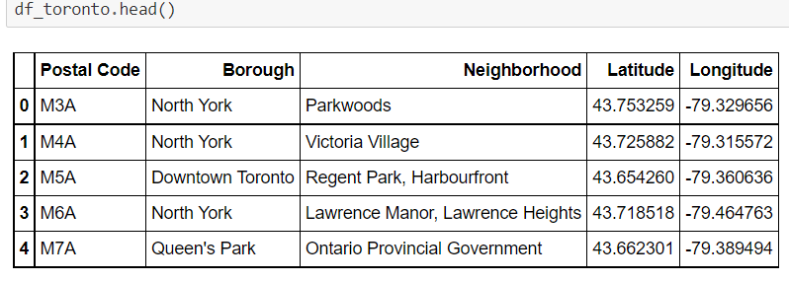
Afer data downloading, preprocessing and cleaning we have the resulting dataframe for New York city and Toronto

Slide 13
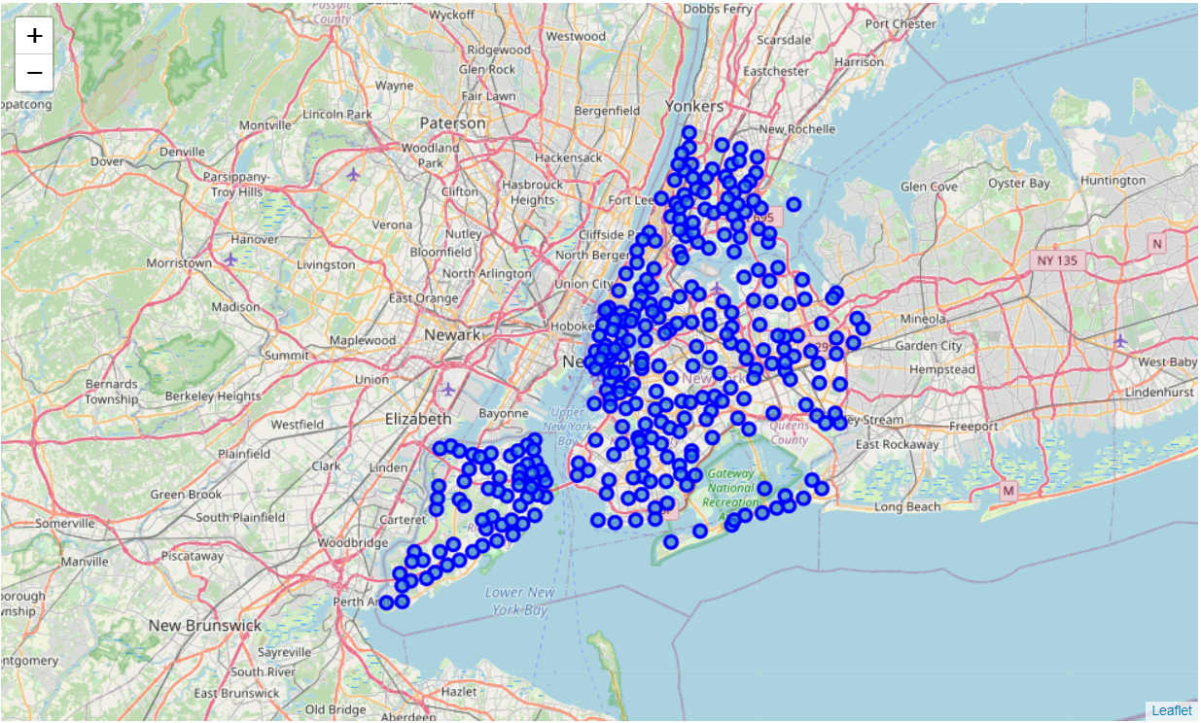
Visualizing the neighborhoods of New-York city and Toronto Creating a map of New York city with neighborhoods superimposed on top using folium library.

Slide 14
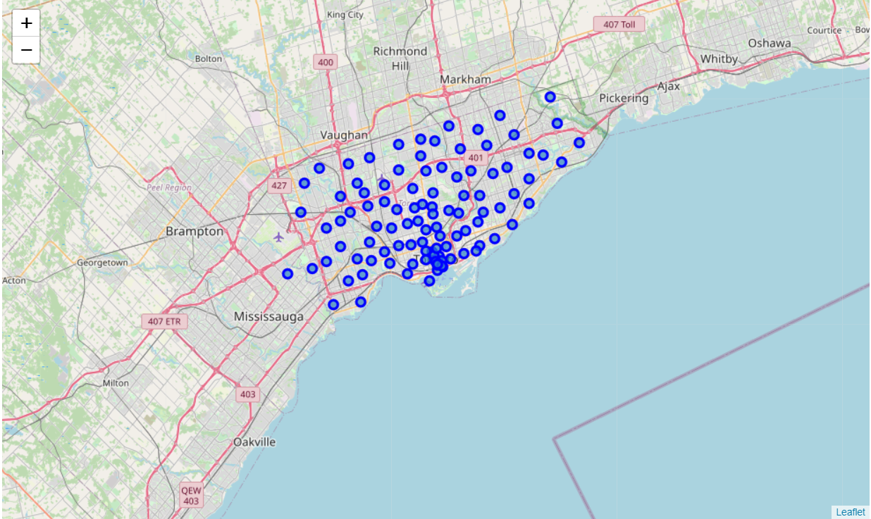
Creating a map of Toronto with neighborhoods superimposed on top using folium library.

Slide 15
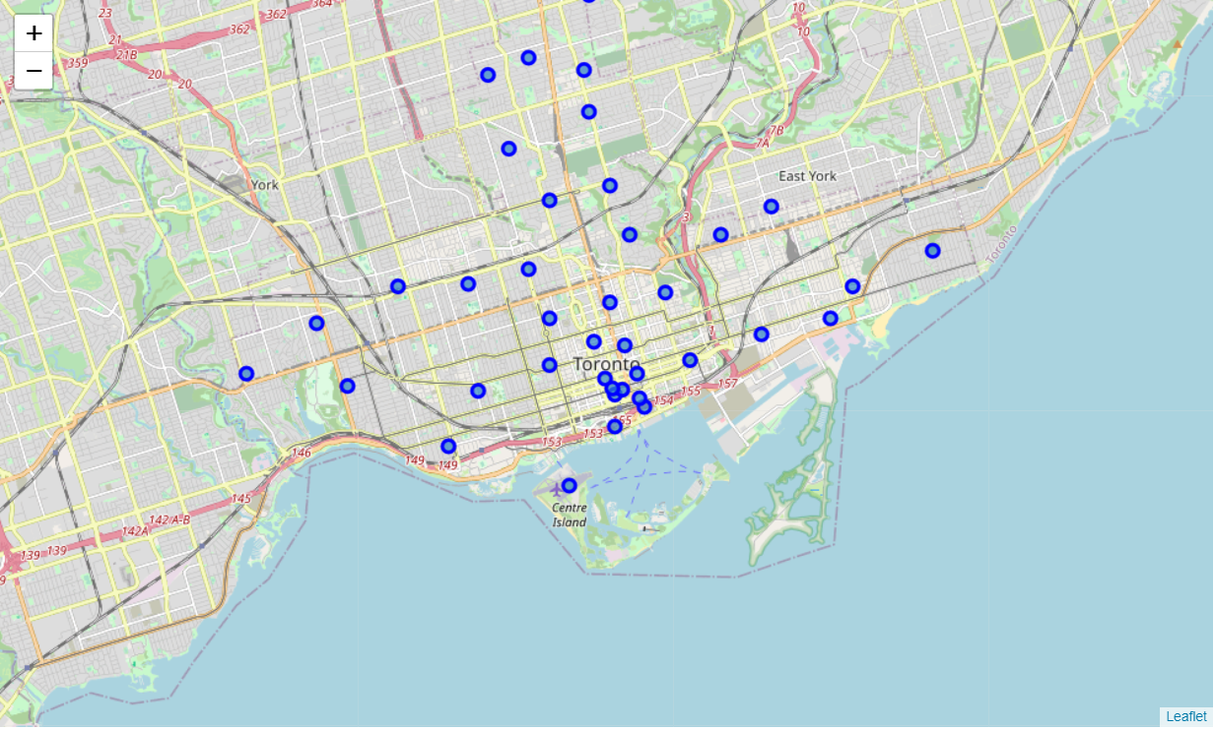
Creating a map of Toronto with neighborhoods which contains Toronto word in their Borough name using folium library.

Slide 16
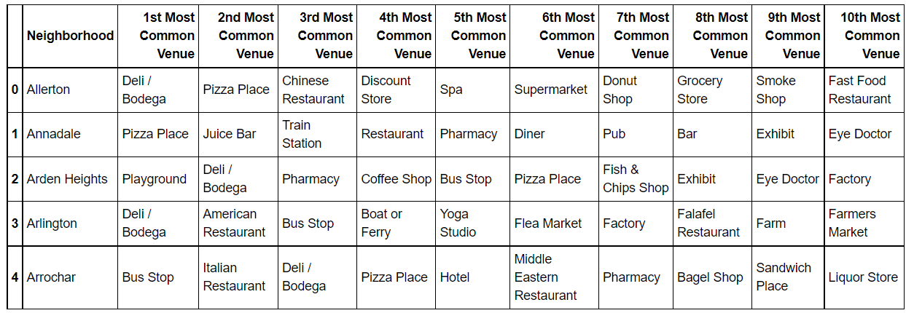
New York : check the 10 most common venues in each neighborhood.

Slide 17
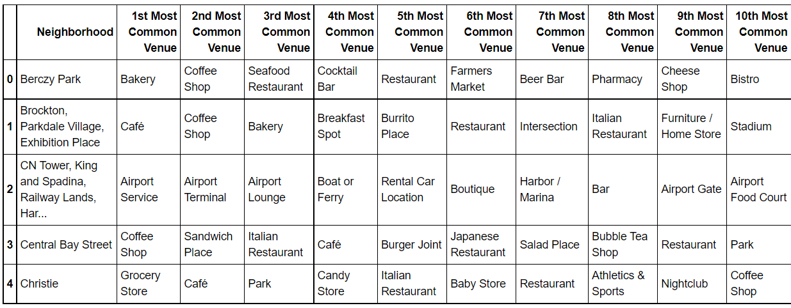
Toronto : check the 10 most common venues in each neighborhood.

Slide 18
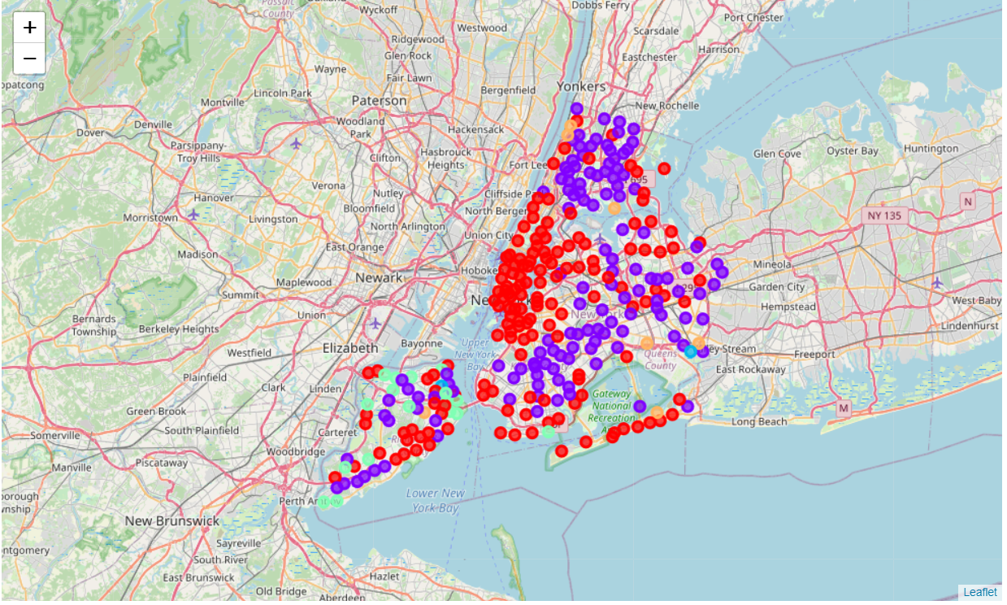
New York : Cluster Neighbourhoods

Slide 19
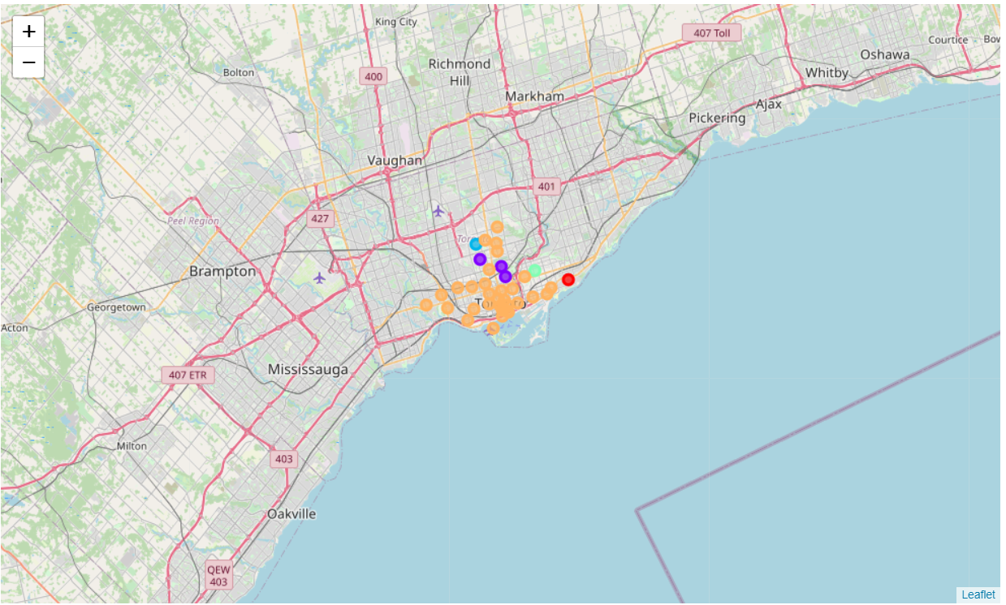
Toronto : Cluster Neighbourhoods

Slide 20
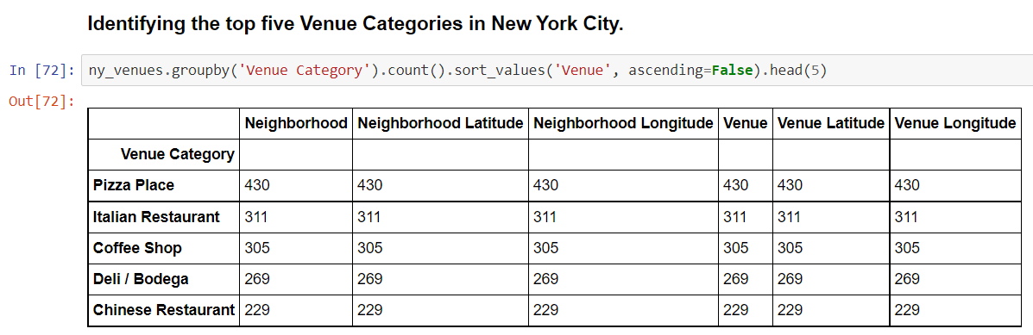
Identifying the top five venue categories in New York city.

Slide 21
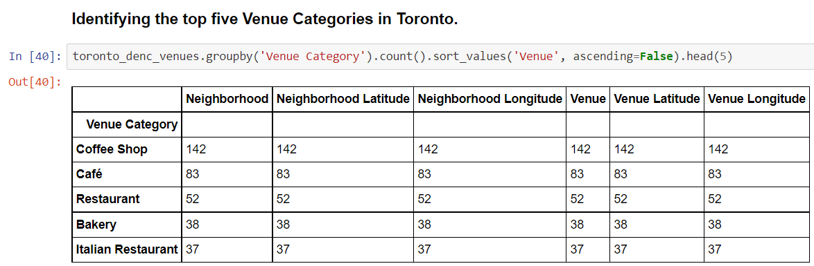
Identifying the top five venue categories in Toronto.

Slide 22
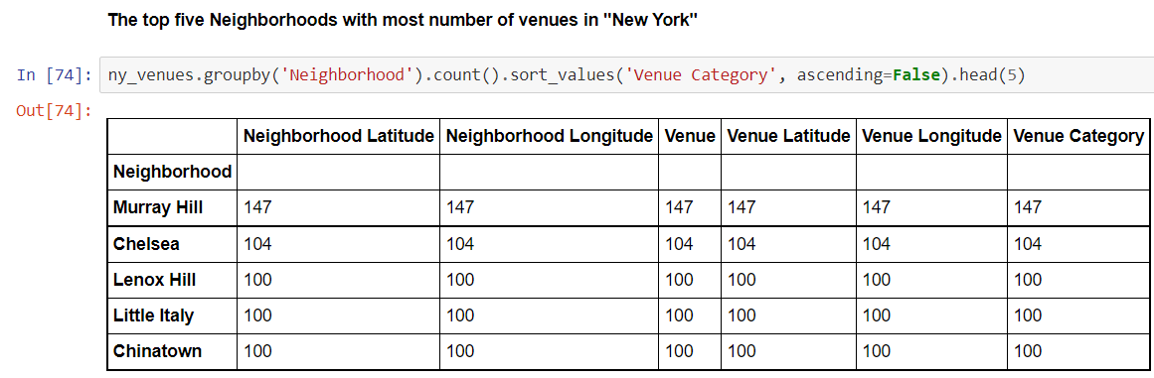
Identifying the top five neighborhoods with most number of venues in its neighborhood.

Slide 23
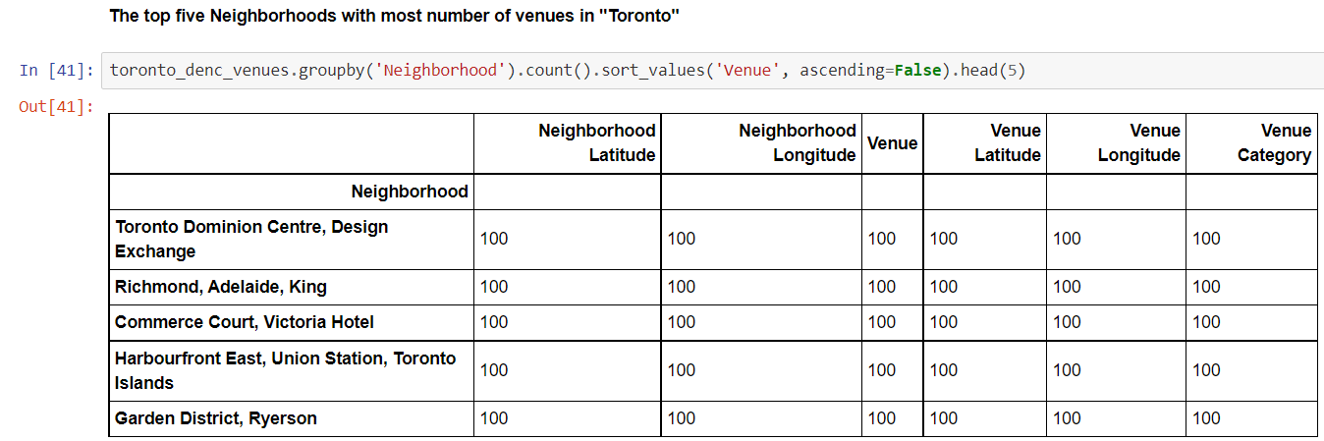
Identifying the top five neighborhoods with most number of venues in its neighborhood.

Slide 24
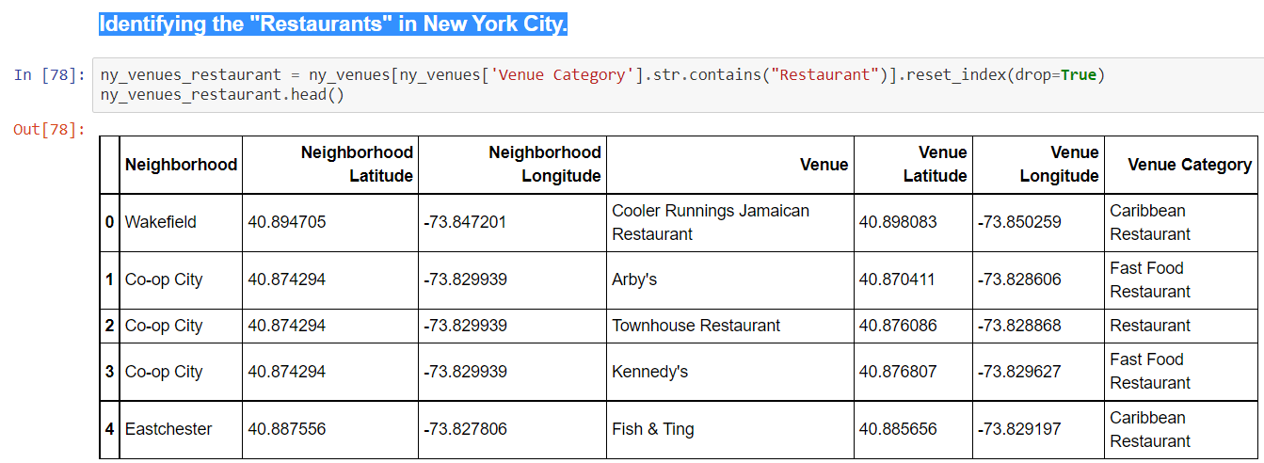
Identifying the "restaurants" in New York city.

Slide 25
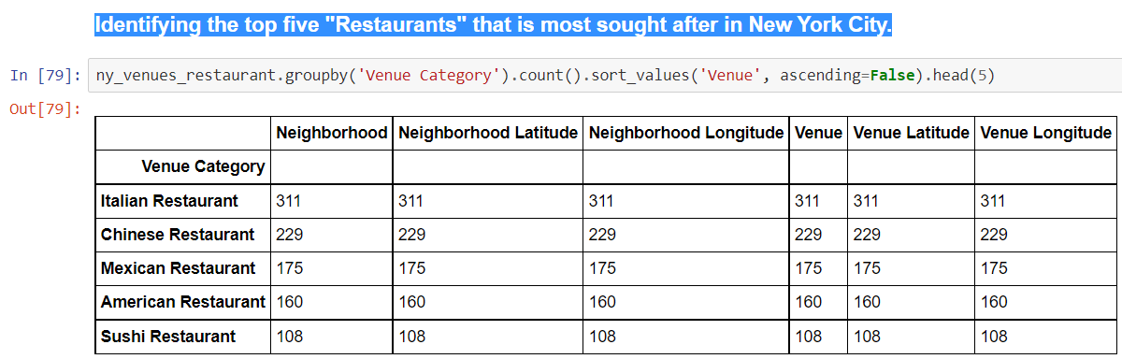
Identifying the top five "restaurants" that is most sought after in New York city.

Slide 26
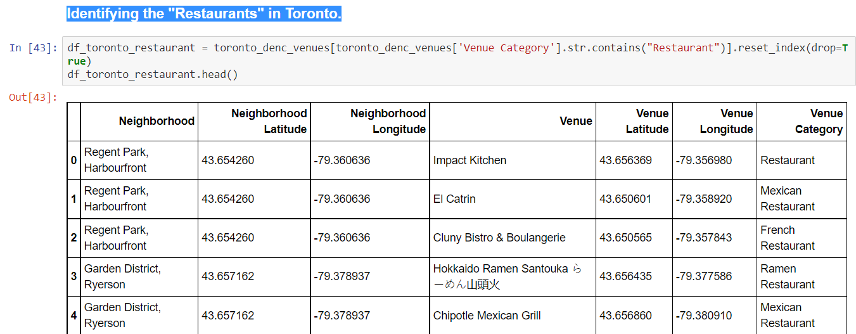
Identifying the "restaurants" in Toronto.

Slide 27
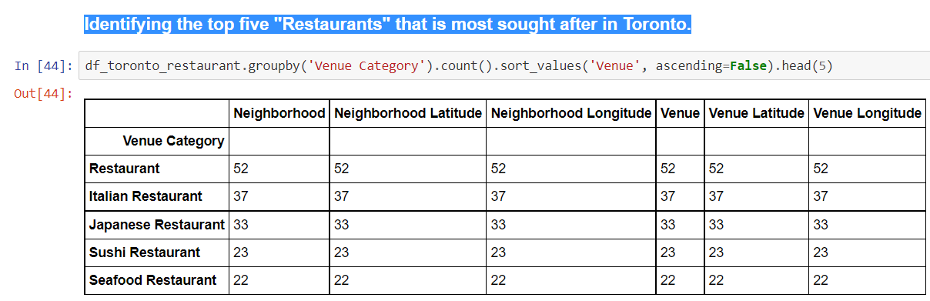
Identifying the top five "restaurants" that is most sought after in Toronto.

Slide 28
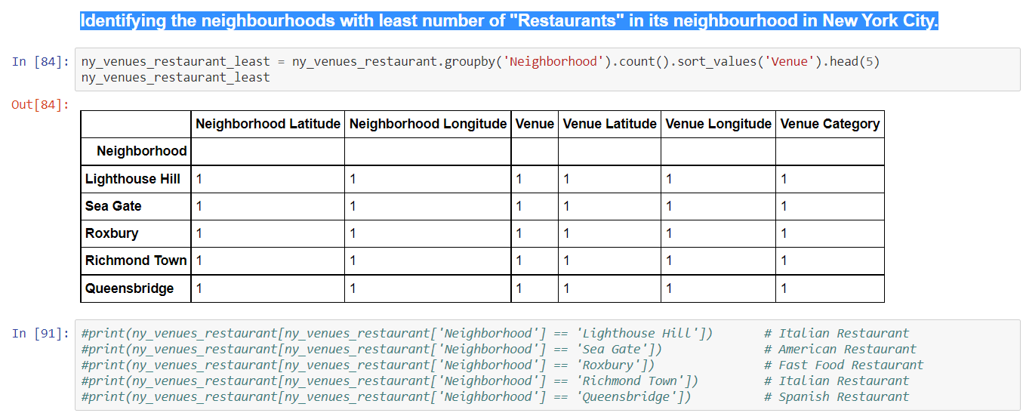
Identifying the neighbourhoods with least number of "restaurants" in its neighbourhood in New York city.

Slide 29
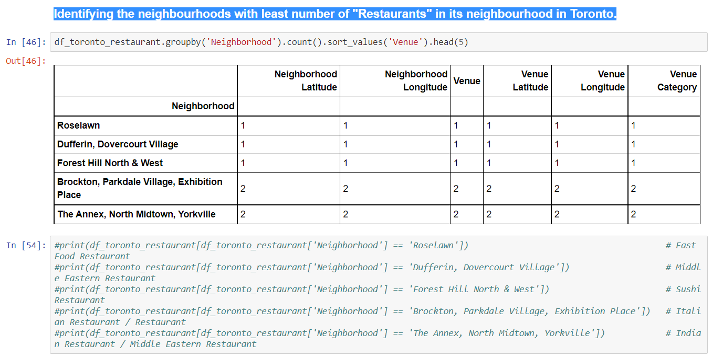
Identifying the neighbourhoods with least number of "restaurants" in its neighbourhood in Toronto.

Slide 30
Discussion
There are lots of venues available in both New-York city and Toronto. While Italian Restaurant, Coffee Shop are top common Venue Categories across both the cities, New York city is also famous for Pizza Place, Deli / Bodega and Chinese Restaurant, while Toronto is also famous for Café, Restaurants and Bakery.
New-York city has Murray Hill, Chelsea, Lenox Hill, Little Italy and Chinatown neighborhoods with most number of venues while Toronto has Toronto Dominion Centre, Richmond, Adelaide, Commerce Court, Harbourfront East, Union Station, Toronto Islands, Garden District, Ryerson etc with most number of venues.
The neighbourhoods of New-York city and Toronto are very mulitcultural. There are lots of different cusines available in both the cities.While Italian and Sushi Restaurants are common in both the cities, New York is also famous for Chinese, Mexican, American Restaurants and Toronto is also famous for Japanese and Seafood Restaurants.

Slide 31
Conclusion
The purpose of this project was to explore the neighbourhoods of New-York city and Toronto and see how neighbourhoods offer better amenities to potential tourists and migrants. We explored both the cities based on their latitude and longitude information and then extrapolated the venues present in each of the neighbourhoods and clustering nearby neighbourhoods together.
We could see that each of the neighbourhoods in both the cities have a wide variety of experiences to offer which is unique in it's own way. The cultural diversity is quite evident which also gives the feeling of a sense of inclusion.
Both New-York city and Toronto seem to offer better amenities with lots of places to explore, beautiful landscapes, amazing food and a wide variety of culture. Overall, it's upto the stakeholders to decide which neighbourhoods / venues they would prefer more based on their interest.

Slide 32
References
Wikipedia - New York City and Toronto Pages
https://en.wikipedia.org/wiki/New_York_City
https://en.wikipedia.org/wiki/Toronto
List of postal codes of Canada: M
https://en.wikipedia.org/wiki/List_of_postal_codes_of_Canada:_M
Kaggle: https://www.kaggle.com
GitHub: https://github.com
Foursquare - Independent Location Data Platform
https://foursquare.com

